Slide 1
Ch-5
Network Devices

Slide 2
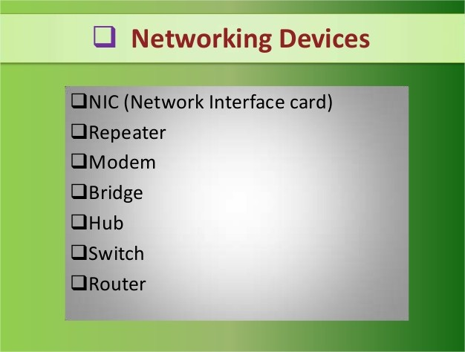

Slide 3
Network Devices
Layer 1 Devices
LAN Card
MODEM
Layer 2 Devices
SWITCH
Wireless Network
Layer 3 Devices
DSL & ADSL
HUB
REPEATER
BRIDGE
ROUTER
BROUTER
GATEWAY
Network Printer
Wireless switch
Wireless router
Access Point

Slide 4
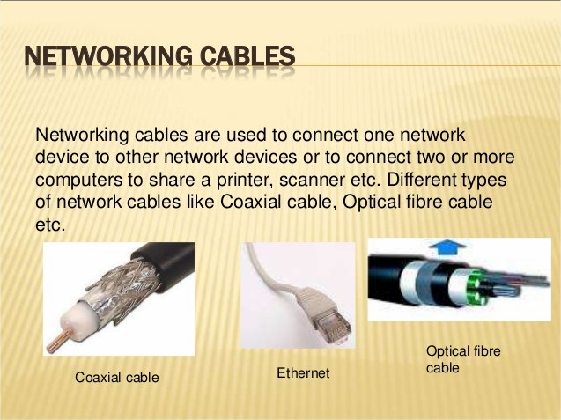

Slide 5
Layer 1 devices

Slide 6
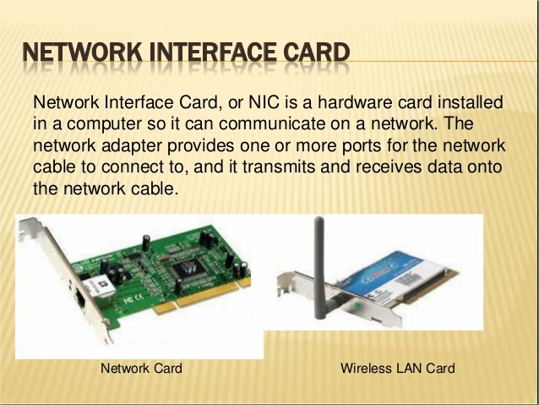

Slide 7
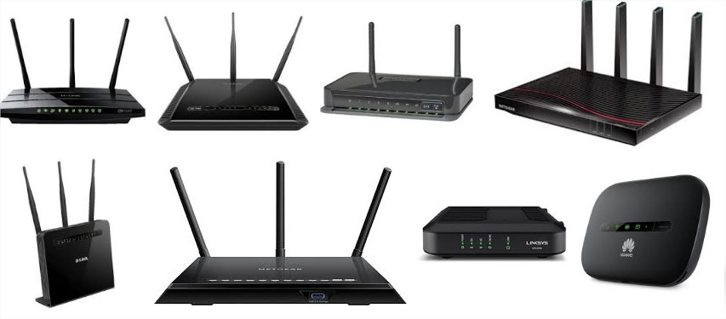
modem
A modem is a device or program that enables a computer to transmit data over, for example, telephone or cable lines.
Computer information is stored digitally, whereas information transmitted over telephone lines is transmitted in the form of analog waves.

Slide 8
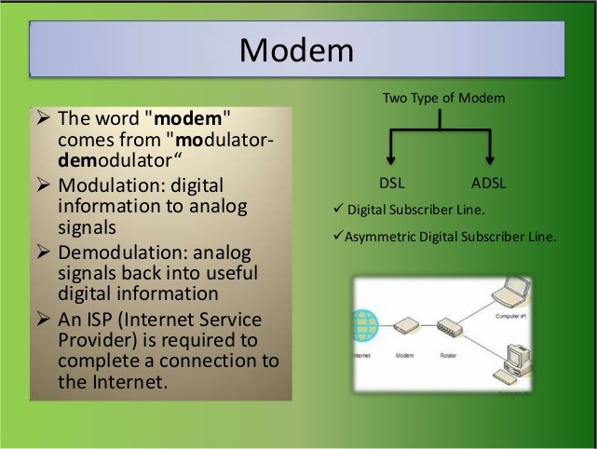

Slide 9
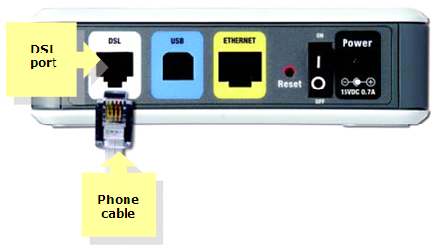
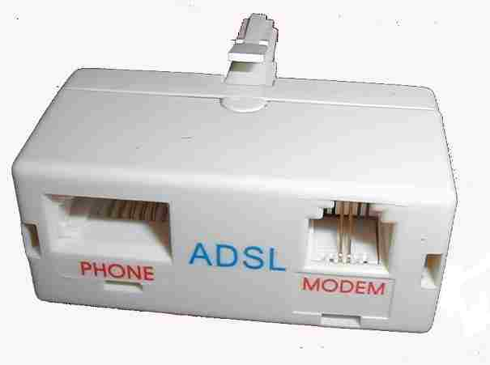
dsl and adsl
Asymmetric digital subscriber line (ADSL) is a type of digital subscriber line (DSL) technology.
A data communications technology that enables faster data transmission over copper telephone lines than a conventional voiceband modem can provide.
ADSLdiffers from the less common symmetric digital subscriber line (SDSL).

Slide 10
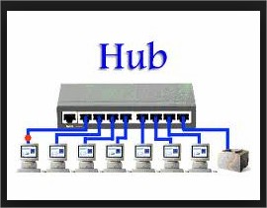
hub
T-Hub (Telangana Hub) is India's largest incubator for startups, located in Hyderabad, Telangana.
A hub, also called a network hub, is a common connection point for devices in a network.
Hubs are devices commonly used to connect segments of a LAN. ... When a packet arrives at one port, it is copied to the other ports so that all segments of the LAN can see all packets.

Slide 11
HUB
Active
Passive
Smart

Slide 12
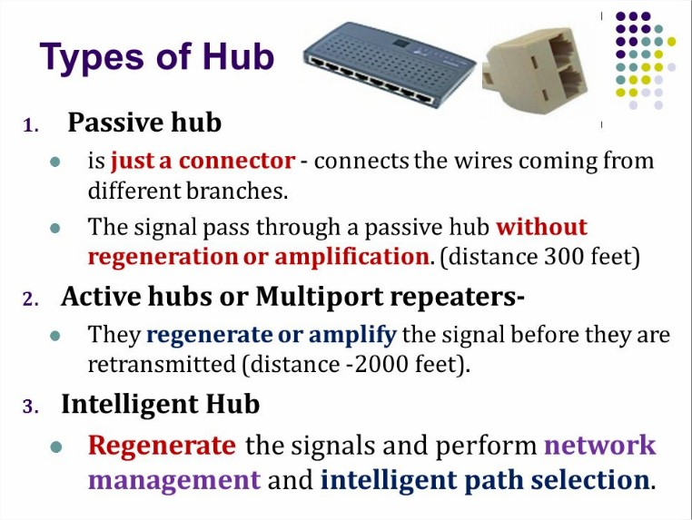

Slide 13
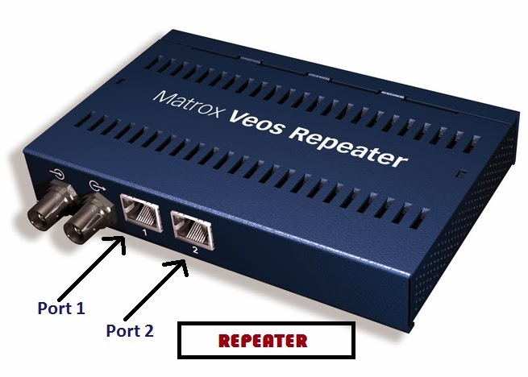
repeater
In telecommunications, a repeater is an electronic device that receives a signal and retransmits it.
Repeaters are used to extend transmissions so that the signal can cover longer distances or be received on the other side of an obstruction.

Slide 14
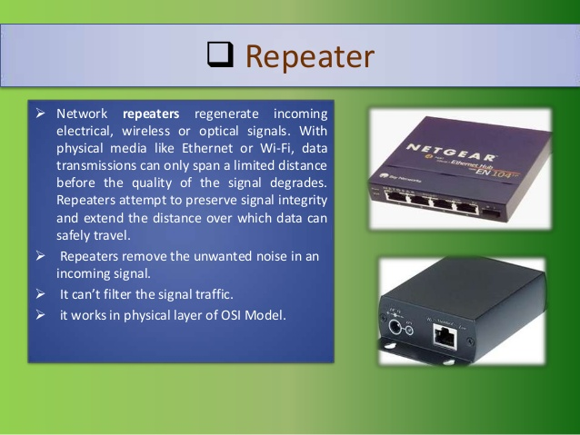

Slide 15
Layer 2 devices

Slide 16
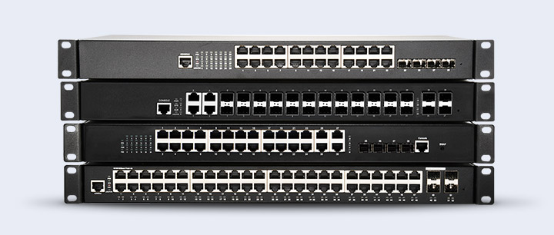
switched
A switched communication network is communication network which uses switching for connection of two non-adjacent nodes. (type:→Circuit, message ,packet switched networks.)
Main two types : manageable and non management

Slide 17
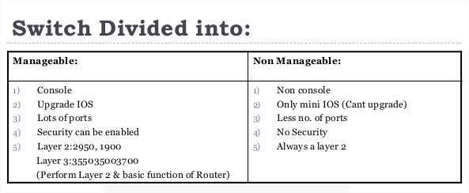
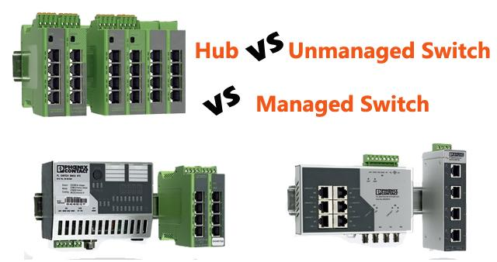

Slide 18
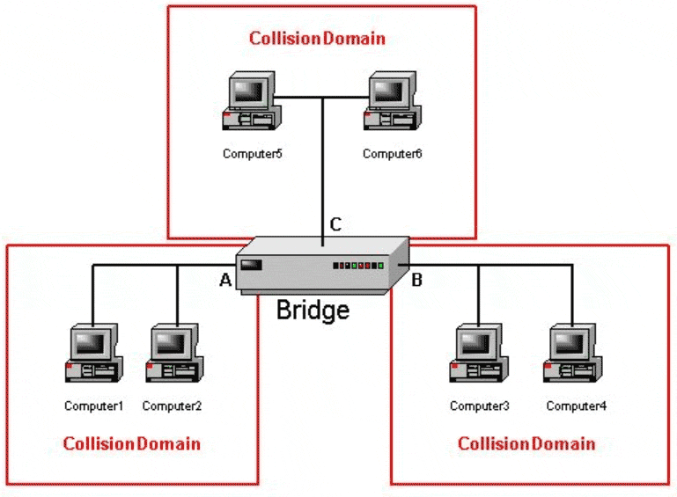
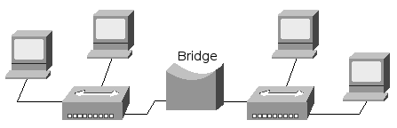
bridge
A network bridge is a computer networking device that creates a single aggregate network from multiple communication networks or network segments.
This function is called network bridging. ... In the OSI model, bridging is performed in the first two layers.

Slide 19
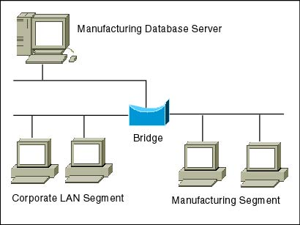
A bridge is a device that connects and passes packets between two network segments that use the same communications protocol.

Slide 20
Layer 3 devices

Slide 21
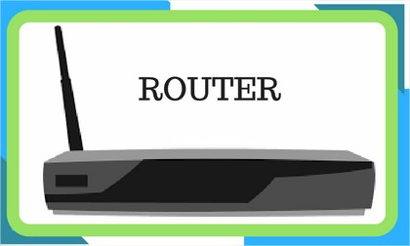
router
A router is a networking device that forwards data packets between computer networks.
Routers perform the traffic directing functions on the Internet.
A data packet is typically forwarded from one router to another router through the networks that arrange an internet work until it sending its destination node.

Slide 22
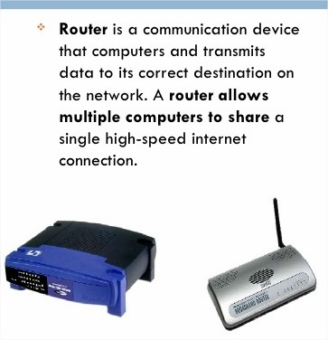

Slide 23
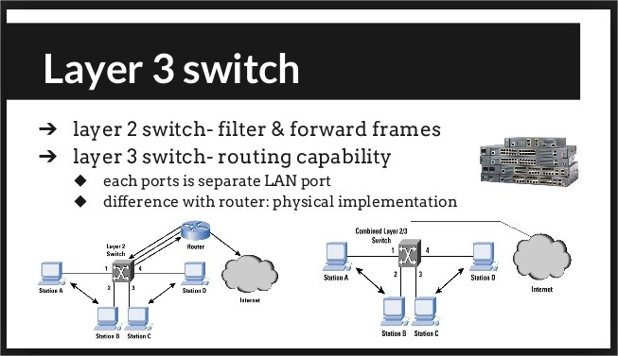
Layer3 switch
Layer 3 switch (also called a multilayer switch).
A Layer 3 switch is a specialized hardware device used in network routing.

Slide 24
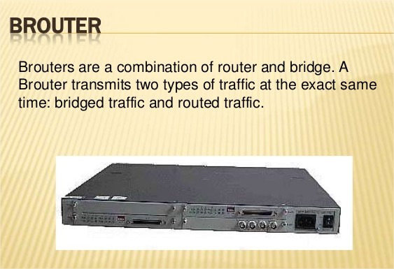
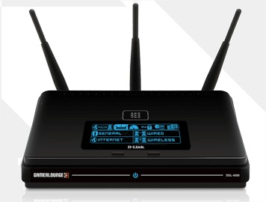
brouter
A brouter is a network bridge and a router combined in a single product.
A bridge is a device that connects one local area network (LAN) to another local area network that uses the same protocol (for example, Ethernet or token ring).

Slide 25
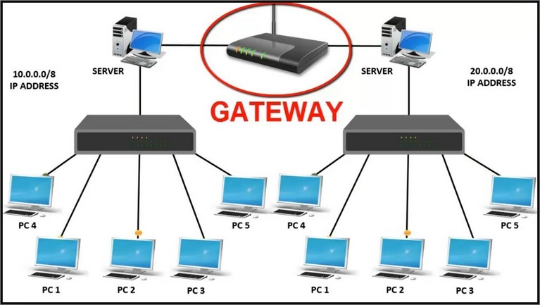
gateway
A gateway is a hardware device that acts as a "gate" between two networks.
It may be a router, firewall, server, or other device that enables traffic to flow in and out of the network.

Slide 26
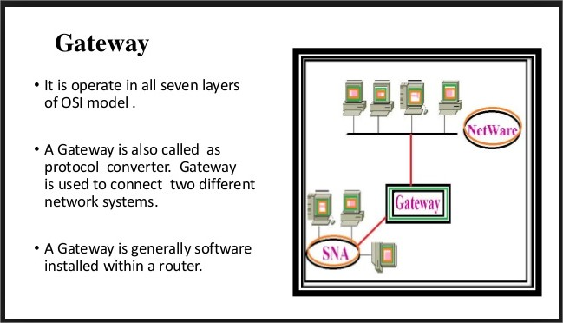

Slide 27
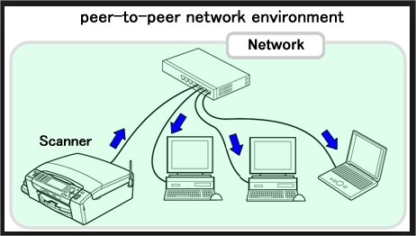
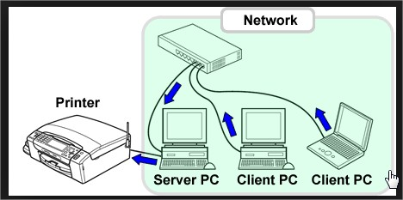
network printer
A network printer is a printer that is accessible by network connection, making it usable by other computers connected to the network.
The printer may have its own network connection, or use the network connection of a single dedicated computer to which it has a local connection.

Slide 28
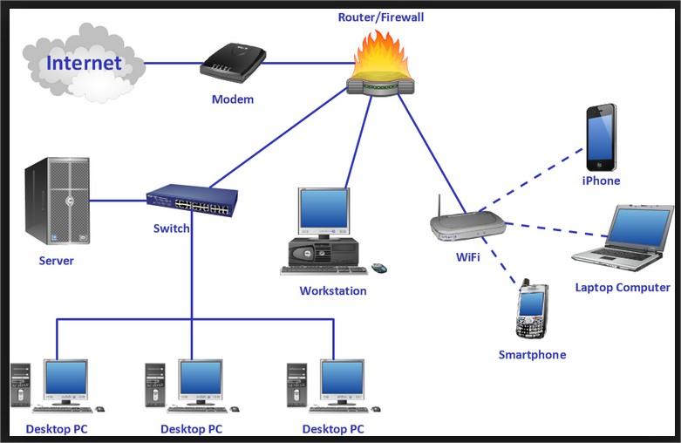

Slide 29
Wireless Network Devices

Slide 30
What is a wireless network?
Wireless networks are computer networks that are not connected by cables of any kind.
Wireless networking is a method by which homes, telecommunications networks and business installations avoid( cancel )
the costly process of introducing cables into a building, or as a connection between various equipment locations.

Slide 31
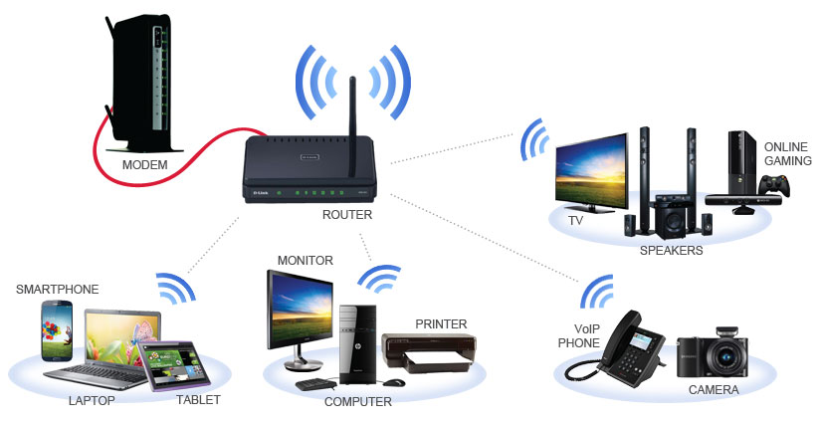
Wireless Network Devices

Slide 32
wireless networks
Most wireless networks are made using Access Points –
devices that host and control the wireless connection for laptops,
tablets, or
smart phones.

Slide 33
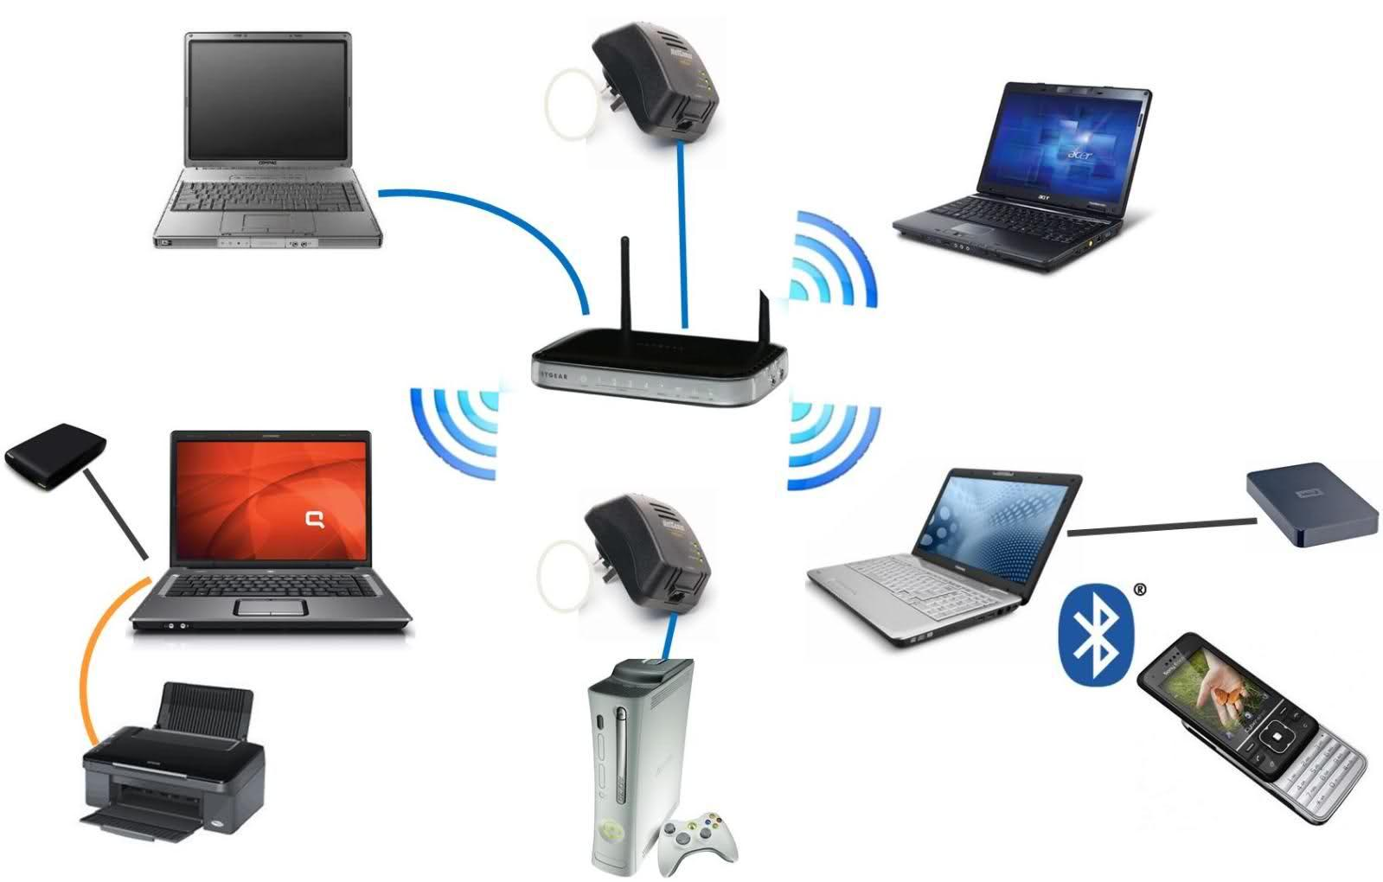
Wireless Network Devices

Slide 34
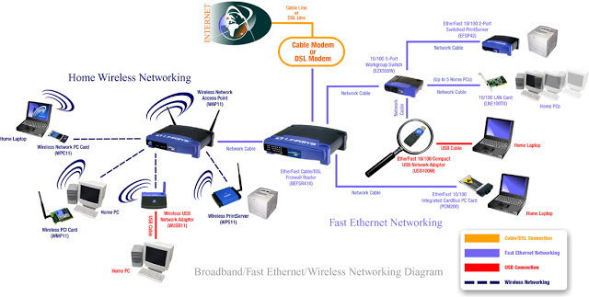
Wireless Network

Slide 35
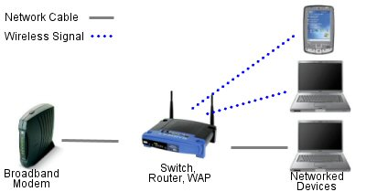
What is a wireless witch or Hub?
These two devices provide the same function on a network, connecting all the devices together - although nobody has used hubs for a long time now.
The two devices use different ways to deliver network traffic.
A hub sends the traffic to all connected computers in the hopes that one of the computers is the right one.
A switch on the other hand has a list of what is connected and sends the traffic to the right place.

Slide 36
What is a wireless router?
A wireless router is an electronic device that works as a router
— meaning it sends data from the internet cable to a device
— and as a wireless access point so this data can be shared through radio signals instead of another cable.
The Wi-Fi router then takes this data and converts it into radio signals, which are then picked up by devices with Wi–Fi capability such as laptops, tablets, smartphones and games consoles.

Slide 38
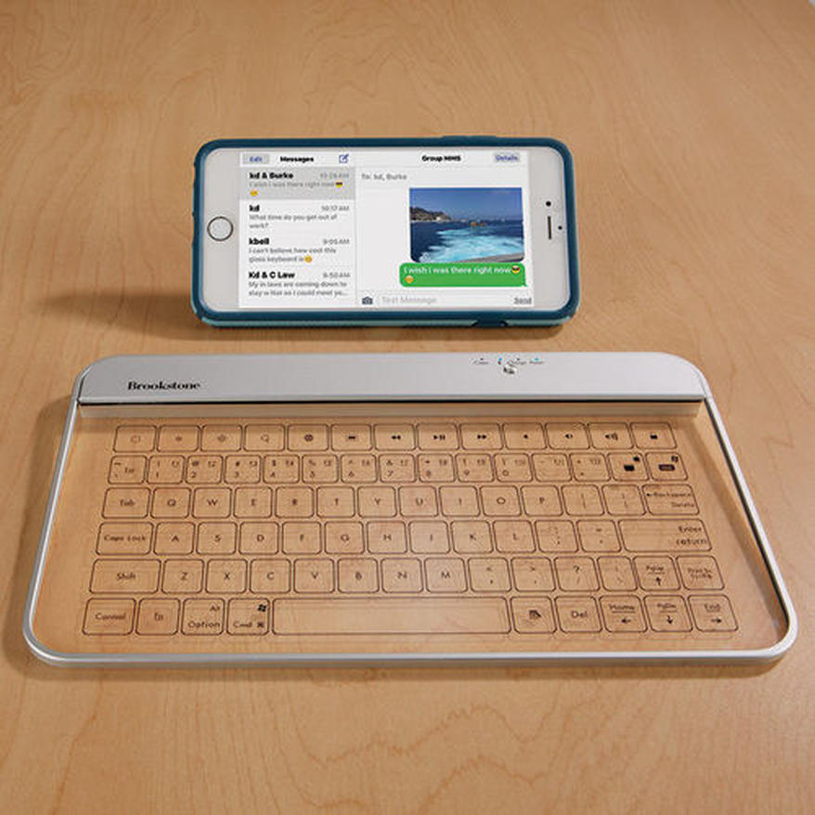

Slide 39
ACCESSPOINT
access point is a device that creates a wireless local area network, or WLAN, usually in an office or large building.
An access point connects to a wired router, switch, or hub via an Ethernet cable, and projects a Wi-Fi signal to a designated area.

Slide 40
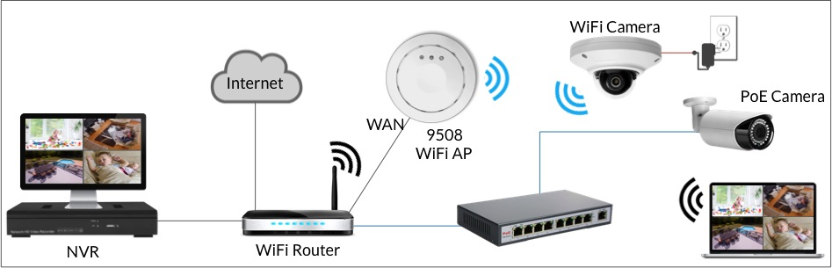

Slide 41
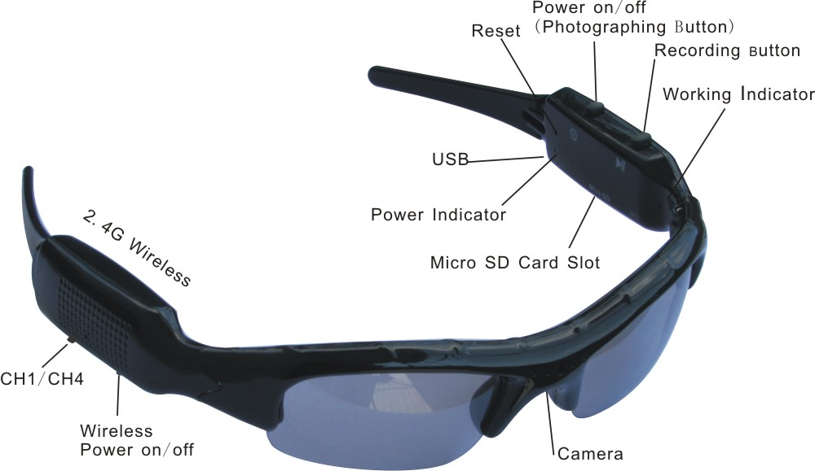
Wireless Glasses Camera

Slide 42
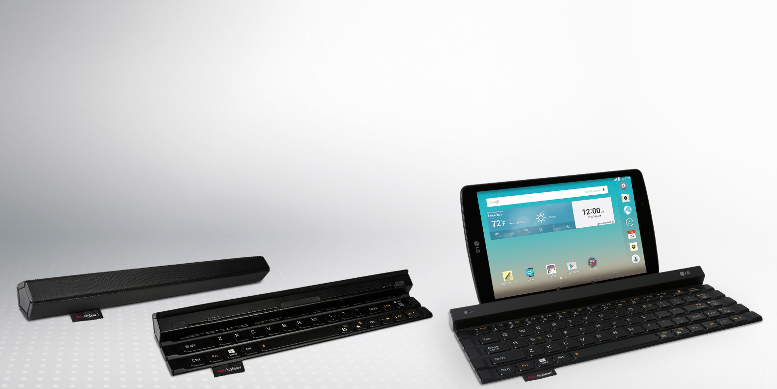
Wireless Keyboards for Tablets

Slide 43



Slide 44


wireless bluetooth

Slide 45
Thank you
???

